Slide 1
Green Cities Development
Association International des Maires Francophones
Presentation par Innocent Kabenga
Representant Resident de GGGI en Ethiopie.
Le 3 Juin, 2019

Slide 2
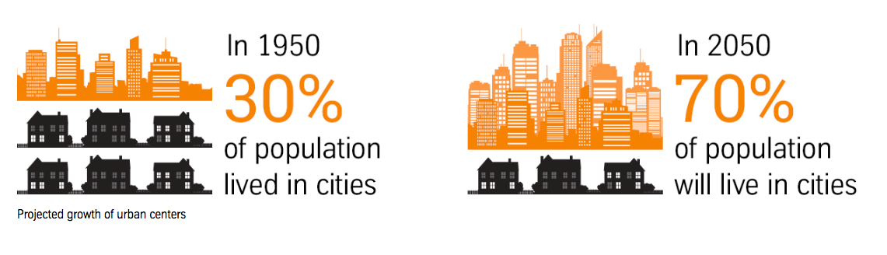
Our Urban Future
70% of the world’s population will live in cities by 2050.
70% of GDP will be generated in cities.
Urban areas currently account for 70% of energy-related global greenhouse gases.

Slide 3
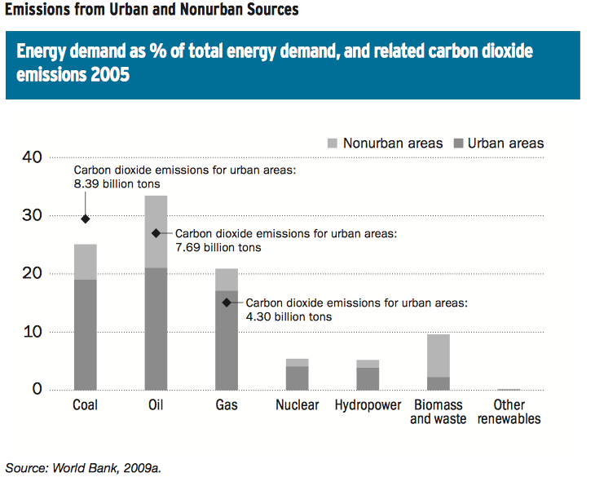
Challenges of Urbanization – Resource inefficiency and Air pollution
Urban areas currently account for 70 percent of energy-related global greenhouse gases.
Cities approximately meet 72 percent of their total energy demand from coal, oil, and natural gas—the main contributors to greenhouse gas emissions.
Leading to greater air pollution with significant impact on human health.

Slide 4
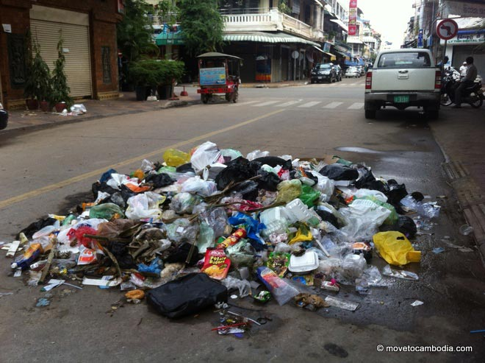
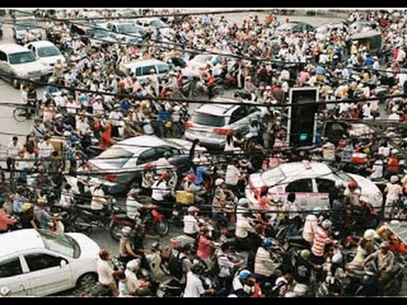
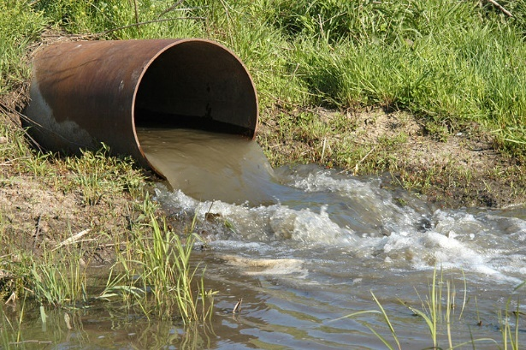
Challenges of Urbanization
Limited infrastructure services for all
Waste management
Transport
Water supply and sewage
Intensive and rapid urban growth make local governments unable to provide basic infrastructure services for all people

Slide 5
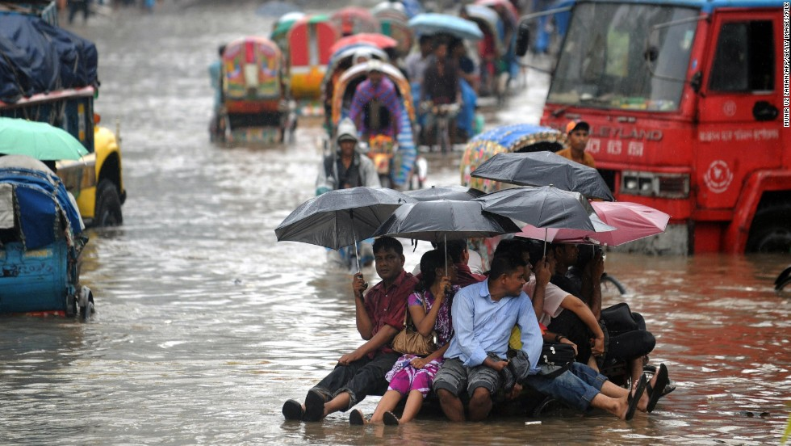
Challenges of Urbanization
Vulnerability to Climate change and social instability
Fifteen of the world’s twenty megacities (over 10 million inhabitants) are located in coastal zones threatened by sea-level rise and storm surges.
40% of the world’s urban expansion takes place in slums
Unplanned urban expansion and limited urban infrastructure can exacerbate socio-economic disparities, leaving the urban poor most vulnerable to effect of climate change.
Notes:
Fifteen of the world’s twenty megacities – those with over 10 million inhabitants – are located in coastal zones threatened by sea-level rise and storm surges. Making cities more resilient to extreme weather events should be a priority for both local governments and the private sector.
Estimates suggest that 40% of the world’s urban expansion is taking place in slums, exacerbating socio-economic disparities and creating unsanitary conditions that facilitate the spread of disease.

Slide 6
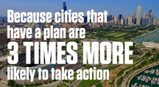
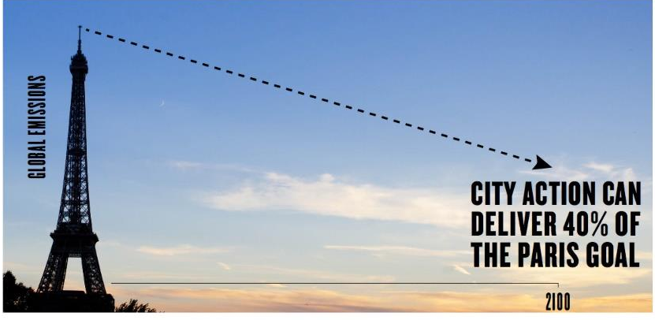
‘Traditional’ responses: their limits & the need to act now
‘Business as Usual’ cities are unable to transform their development models from exploitation to investment:
To benefit from synergies;
To decouple resource use from growth;
To break through the middle income & resource inefficient urban trap;
To provide opportunity;
To become/remain competitive and attractive to investment.
Future cities cannot be prosperous & sustainable through Business-as-Usual development models
There are resource and other limits to BAU models of exploitation

Slide 7





GGGI’s urban sector – Four priority areas to transform cities
1. Mainstreaming Green Growth into Urban Planning & Management
Viet Nam – Urban Green Growth Action Project
Rwanda – National Roadmap for Green Secondary City Development
Cambodia – Green City Strategic Planning Methodology, Green City Strategic Plan for Phnom Penh
Nepal – Green Municipality Development Strategy
2. Resource Efficient & Low-Carbon Cities
Mongolia – Low Carbon and cost efficient public infrastructure model
Pacific region – Urban Eco-system Based Adaptation
Kiribati – Climate Resilient Island Development
Current Demands
3. Solid Waste Management & Managing Waste as Resource
Secondary City Development
Secondary City Development
Laos – Pro-poor solid waste management project
Uganda – Waste to energy resource projects
Solid waste Management
5. Sustainable Transportation & Mobility: Connected & Heath Cities
Mexico – Transforming transpiration in urban areas
Cambodia – Supporting non-motorized mobility

Slide 8
GGGI’s Urban Footprint
18
Membership
Members of GGGI
Countries that have formally expressed intent to join GGGI
Mongolia
Republic of Korea Headquarters
Programs
Morocco
Nepal
Mexico
Lao PDR
Viet Nam
Countries where GGGI currently has operations
Senegal
Cambodia
Sustainable Energy Projects
Uganda
Rwanda
Green Cities Projects
Water and Sanitation Projects
Sustainable Landscapes Projects
Cross Cutting Projects
Green Finance
Countries where GGGI has completed programs
Australia, Brazil, Burkina Faso, Cambodia, China, Colombia, Comoros, Costa Rica, Denmark, Ethiopia, European Union, Fiji, Guyana, Hungary, India, Indonesia, Jordan, Kazakhstan, Kiribati, Republic of Korea, Lao PDR, Mexico, Mongolia, Morocco, Mozambique, Myanmar, Nepal, Norway, Papua New Guinea, Pakistan, Paraguay, Peru, Philippines, Qatar, Rwanda, Senegal, Sri Lanka, Thailand, Tonga, Uganda, United Arab Emirates, United Kingdom, Vanuatu, Viet Nam

Slide 9








Towards Green Cities: Key Transformations
The way we plan
To achieve smart, green & sustainable cities
The way buildings are designed & operated
For a resource efficient & low carbon built environment
The energy produced & consumed
Access to renewable energy & efficiency
Waste to resources
Close the waste/resource loop
Water resource management
Access to clean water and sanitation
The way people move and connect
Connected & walkable/less motorized cities
Balancing expansion, growth & opportunity
Pro-poor and inclusive cities
Enhance investment prospects for ‘green finance’
Address how cities manage and account for their assets

Slide 10
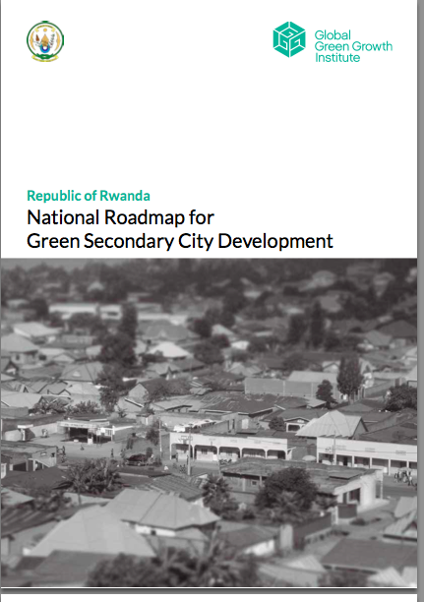
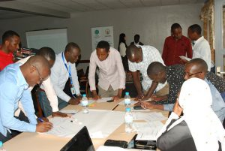
1. Mainstreaming Green Growth into Urban Planning & Management
[Case 1] Planning & CB : ToT on Green Secondary Cities Development, Rwanda
Summary of project
- A biennium project that aims to 1) enhance the capacity of key officials from six secondary cities in green city development 2) identify bankable/financeable projects in GGGI’s thematic priorities and 3) eventually enable them to independently deliver green cities projects/training at the community level.

Slide 11
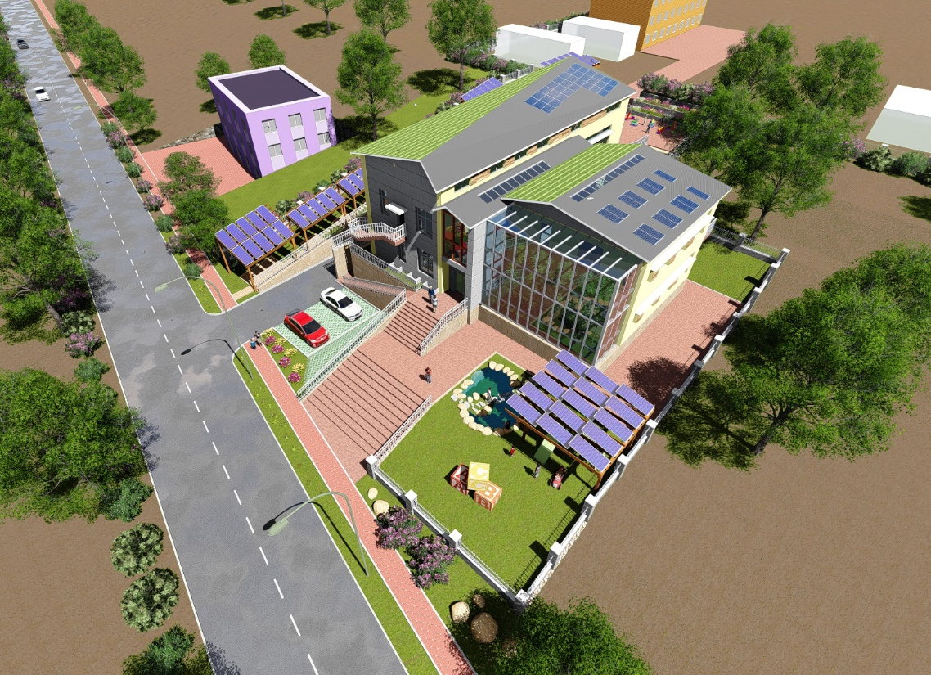
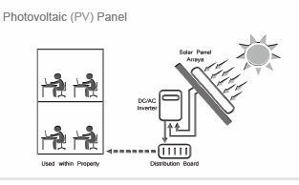
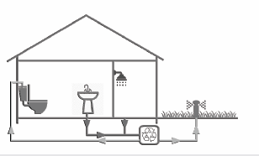
[Case] Policy & Financial Instruments : Resource Efficient & Low-Carbon Cities
Pacific region – Urban Eco-system Based Adaptation
Initiated urban EbA work: first project to identify factors undermining EbA through urbanization and value ecosystems
Mongolia – Green Public Building (PPP)
Government supported to shift towards green procurement of public building (school and kindergarten buildings)
Solid Waste Management
Sustainable Transport & Mobility

Slide 12
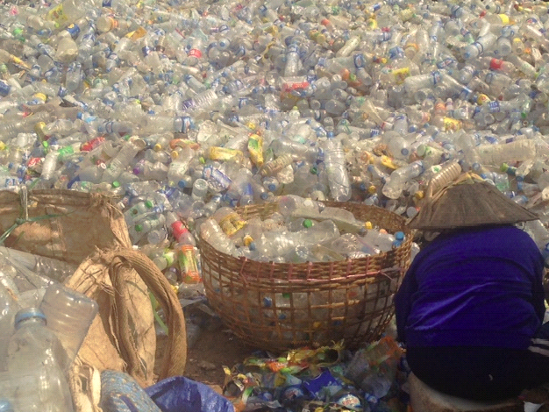
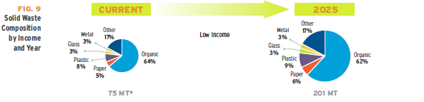
3. Solid Waste Management & Managing Waste as Resource
Innovative solutions which are financially sustainable, generate green jobs in support of waste-to-resource economies, and create healthier cities
Incentivize holistic and integrated approaches to all forms of waste management, inclusive of the waste cycle
Thinking beyond collection as a sole goal – leveraging co-benefits of W2R (Lao PRD, Uganda)

Slide 13

Promoting waste-to-resource in secondary cities of Rwanda
Increasing the waste collection coverage with the promotion of waste separation at source
Improving the waste-to-resource value chain (linking existing actors in the recycling industry)
Establishment of a transit center in support of waste-to-resource practices
Developing a business model for municipal own source revenue generation in the waste sector

Slide 14

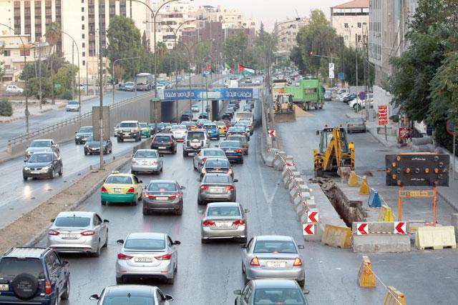
[Case] Greening Amman Bus Rapid Transit (BRT) System
Summary of Project
To green the choice of vehicle fleet for the BRT lines in Amman and facilitate the associate financing.
Intervention areas
Identified the best choice among green vehicle fleets (diesel-powered vehicles, trolley buses, or electric powered buses)
Incorporate the cleaner vehicle requirements into the final tender documents for implementation
Mobilize investment in the choice of greener vehicle fleet for the BRT lines.
Photo: Jordan Times, 2014
Notes:
To green the choice of vehicle fleet for the BRT lines in Amman and Amman-Zarqa(selecting among the diesel-powered vehicles, trolleybuses or electric powered buses using opportunity charge technology) and facilitate the associate financing
Petra photo：http://www.jordantimes.com/news/local/tenders-brt-overpasses-passenger-station-be-floated-week

